Slide 1


Day 1 - Credit Scoring
Building Credit Scoring Model
pacmann.io
© 2022 – Pacmann AI

Slide 2
Outlines
Credit Scoring
Modeling Workflow
Course Administration
Data Preparations

Slide 3
Credit Scoring
Notes:
Transisi antar outline

Slide 4







What is Credit?
image source

Slide 5
Lender & Borrower
Provider lend the money with an obligation.
Lender
(bank, etc.)
Borrower
(client)
Borrower must pay the price of
Creating the impression of trust
Repaying according to the agreed terms.

Slide 6
Lender Risk
Lender
(bank, etc.)
Borrower
(client)
Potential financial impact if the borrower can return the money.

Slide 7
Credit Analytics
This gives rise to concept like:
Creditworthiness
Borrower’s willingness and ability to repay
Credit risk
The potential financial impact of any real or perceived change in borrower’s creditworthiness.

Slide 8
Filtering Gate
What if we can filter the borrower’s creditworthiness?
Filtering gate
Lender
(bank, etc.)
Borrower
(client)
Lender can minimize financial risk of default borrowers

Slide 9
Credit Score
Credit Score
Lender
(bank, etc.)
Borrower
(client)
What is it?
Decision support systems
A risk assessment of potential/existing borrowers

Slide 10
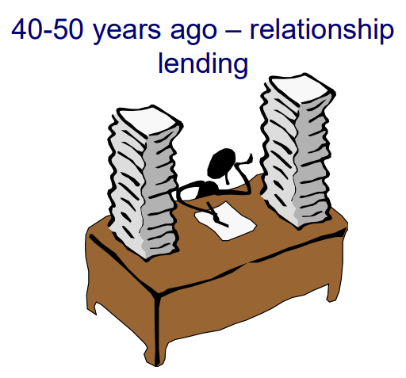
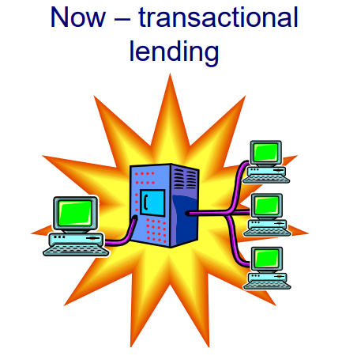
Relationship vs Transactional Lending
Judgemental assessment based on 3(5) Cs (Character, Capacity, Collateral + Capital, Conditions)
Very slow, subjective, often inconsistent
Automated impersonal decisions
Quick & consistent
Copied from Introduction to Credit Risk Modeling, Dr. Galina Andreeva, University of Edinburgh

Slide 11
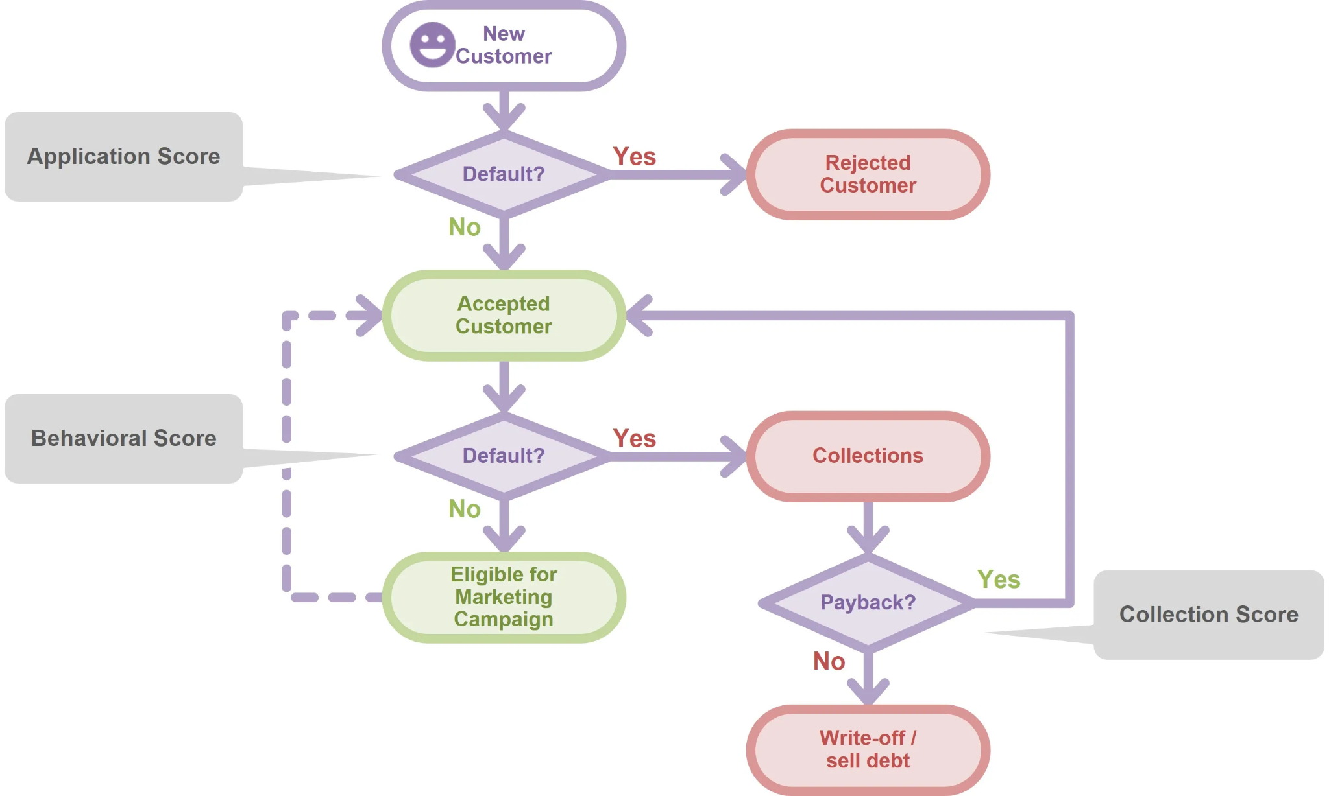
What is scoring used for?
image source

Slide 12
What is scoring used for?
New Customer (application scoring)
Who is likely to default?
Who is likely to respond?
Existing customers
Shall we increase a credit limit?
Can we cross-sell other product?
Problem customers
Shall we sell the debt off?
If not, what method of contacting to be used?
Adapted from Introduction to Credit Risk Modeling, Dr. Galina Andreeva, University of Edinburgh

Slide 13
Basic Idea on Creating a Credit Scoring
Need the data on characteristics & performance of previous borrowers.
Create a model that predict default probability (probability that a borrower is failed to repay in a certain period of time)

Slide 14
Basic Idea on Creating a Credit Scoring
Or
Need the data on characteristics & performance of previous borrowers.
Assign points to each category of borrowers characteristics → reflect the level of risk of this category.
For a new borrower, sum all the points over the relevant characteristics → get an overall score.
Adapted from Introduction to Credit Risk Modeling, Dr. Galina Andreeva, University of Edinburgh

Slide 15
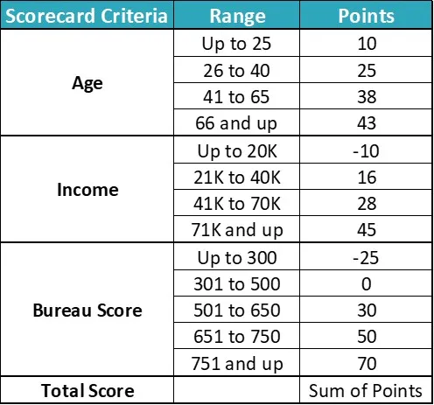
Basic Idea on Creating a Credit Scoring
If a borrower is
age = 27
Income = 35K
Bureau Score = 450
What is his/her credit score?
image source

Slide 16
Modeling Workflow
Notes:
Transisi antar outline

Slide 17
Good vs Bad Potential Borrowers
Say we want to create an application scoring systems.
As a DS, some important questions to answer are
How do I tell “bad” from “good” borrowers?
When the model predicts “bad” and “good” borrowers?
What are the main characteristics that tell “bad” from “good” borrowers?

Slide 18
Good vs Bad Potential Borrowers
How do I tell “bad” from “good” borrowers?
Do they pay 60, 90, or 180 days past due? discuss it with the user.
When the model predicts “bad” and “good” borrowers?
How long should be the outcome period? discuss it with the user.
What are the main characteristics that tell “bad” from “good” borrowers?
Do the EDA (Exploratory data analysis) & gain insight, e.g. borrowers that have regular income are less likely to default or older borrowers are less likely to default.

Slide 19
Modeling Workflow (Simplified)
Data Preparation
Load data
Model Predictions
Create a predictions
Sample selection
Split data to Train, Valid, & Test
Create & Evaluate Model
Create a classification model
Tune the model
EDA
Perform data exploration
Data Preprocessing
Preprocess the data so that can be modeled
Missing value imputation
Remove outliers

Slide 20









Data Science Tools to Use!
Programming Language & interface
___
Data Preprocessing Tools & Modeling
___
API
___
Documentation
___

Slide 21
Course Administration
Notes:
Transisi antar outline

Slide 22
Course Outline
Day 1 - Credit Scoring & Data Preparation
Definition of credit scoring, modeling workflow, & data preparation
Day 2 - EDA & Data Preprocessing
EDA-ing data & preprocess data before modeling
Day 3 - Modeling
Create some classification models & choose the best model.
Day 4 - API
Create credit score predictions using API

Slide 23
The Data
The data source is from Give Me Some Credit Competitions.
For this course, please download the dataset from here

Slide 24
Data Preparations
Notes:
Transisi antar outline

Slide 25
Data Preparations
Main objectives
Load data
Define its validity
Split data to train, valid, & test
Let’s create that!

Slide 26
Modeling with Python! 3 yes!
Yes, we are going to code!
Yes, you need to know how to code!
Yes, the Python code is easy enough to read

Slide 27
Let’s Code!
Code references: https://github.com/amalinadhi/credit_analytics
Notes:
Transisi antar outline

Slide 28
Thank You
Notes:
Transisi antar outline

